Slide 1


Software Project Management Report
DeYu Huang
GuangWei Xie、
ZhiQing Liu
2023.03.30

Slide 2
Report outline
01
iPlan
02
Function Introduction
03
Technology
04
Requirement items

Slide 3
01
iPlan

Slide 4





iPlan
Function Introduction
Technology
Requirement items
Background
In daily work and life, a large part of users often use Outlook mailbox, which is the main mail transfer and collaboration client product of Microsoft. It is a standalone application that is integrated into Microsoft Office and Exchange Server. The full integration of email, calendar and contact management features makes Outlook the perfect client for many business users.
However, with the increase of emails and calendars, users need to open outlook mailbox frequently to check emails and calendar information, and the interface has many information that customers do not need to deal with, including advertising sales messages, etc., which to some extent causes time wastage, so iPlan is designed to solve this problem.

Slide 5
02
Function Introduction

Slide 6
iPlan
Function Introduction
Technology
Requirement items
Introduce
Users can configure their personal Outlook mailbox accounts in iPlan, pull emails and calendar information from Outlook mailboxes regularly or manually, and generate their personal schedules after filtering and other processing.
Users can view the current day's schedule, as well as the current week or month's schedule in iPlan, and can also check the corresponding schedule by the sender's email address.
When synchronizing mailbox data, popular words are recorded according to email headers (the headers are processed by word separation), and the top 10 popular words are displayed in the schedule, and users can query related email contents according to keywords.
Besides synchronizing data, users can also add and delete schedules by themselves. Schedule information can be exported to Excel table for offline processing.

Slide 7
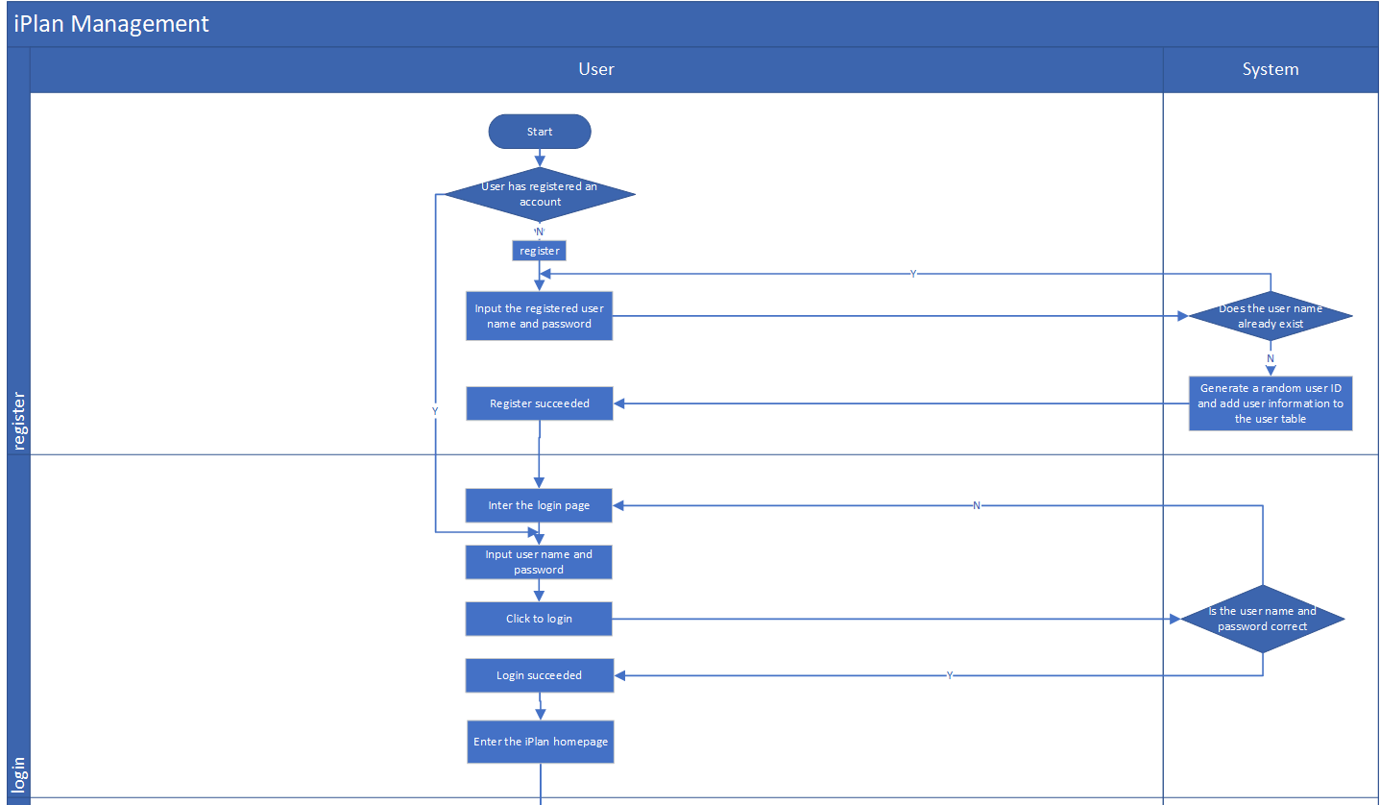
iPlan
Function Introduction
Technology
Requirement items
Registration and Login
Unregistered new users can register by entering their user name and password in the system interface, user names cannot be repeated.
The password is encrypted using MD5 algorithm, and a unique user ID will be generated after registration
Registered users input the correct user name and password to achieve successful login.

Slide 8

iPlan
Function Introduction
Technology
Requirement items
Binding Email
Users binding outlook mailbox need to provide mailbox address and password information, mailbox password is encrypted by MD5 encryption algorithm and saved.
Set up filter keywords against email and calendar headers with both role tags and generic tags.
Users can add filtering mailboxes, which means the corresponding mailbox users will be put into blacklist and the emails sent by this account will not be synchronized.
When binding mailboxes, users need to set the mailbox synchronization start time, such as setting the time as one month ago today, then the system will at most synchronize the data from one month ago to now, and the data further back will not be synchronized.
Affiliated user is the current logged-in user, and the system groups the bound mailboxes by the current user name

Slide 9
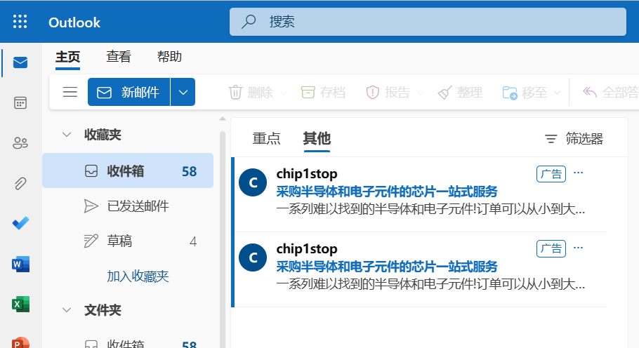
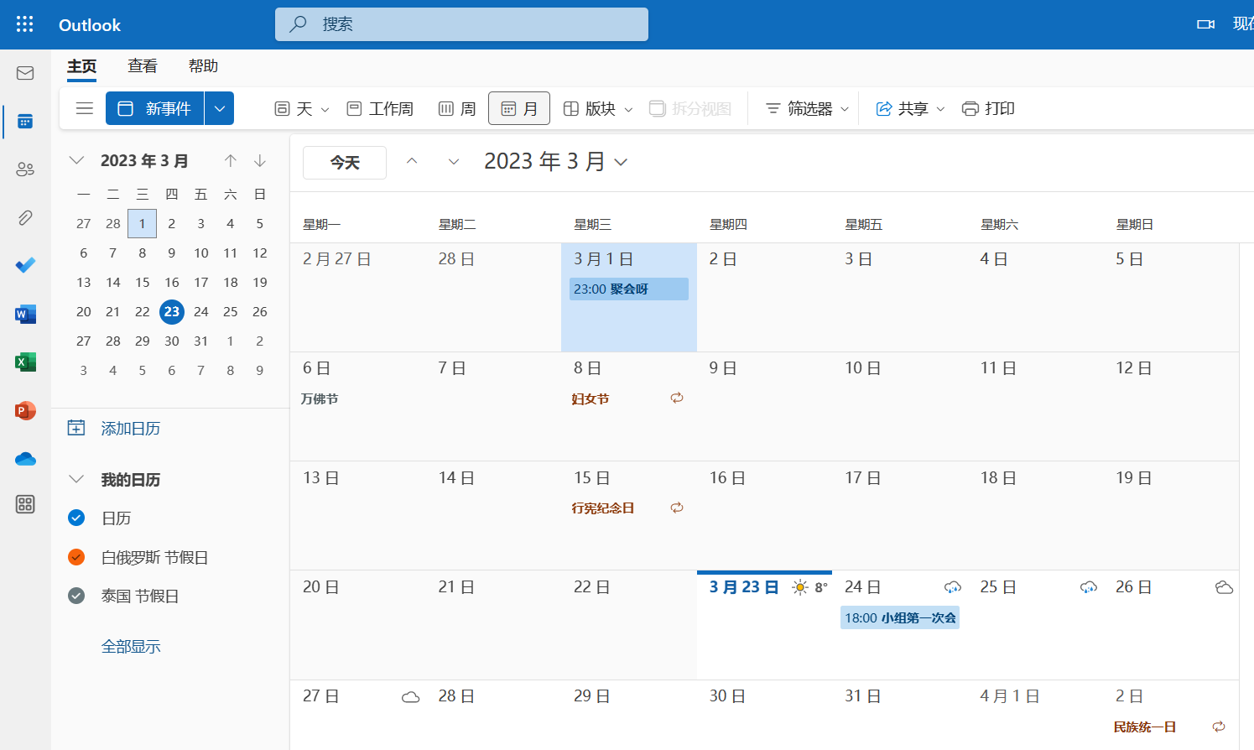
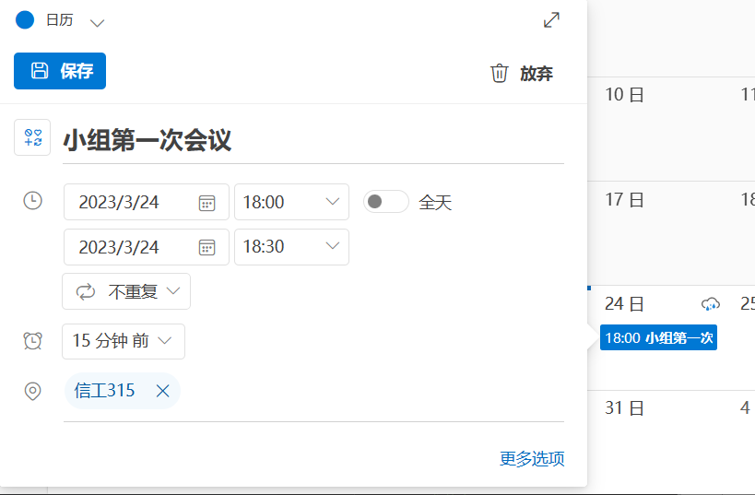
iPlan
Function Introduction
Technology
Requirement items
Synchronize email and calendar data
Use Microsoft exchange protocol to synchronize email and calendar information of outlook mailbox
Filter keywords and blacklist emails to filter the data, similarity over 80% will not be synchronized.
The system will synchronize data once by default for bound mailboxes, and will synchronize data regularly every day, and can also synchronize manually. The start time of each mailbox synchronization will be updated to the latest incoming time as the starting time of the next mail synchronization.

Slide 10
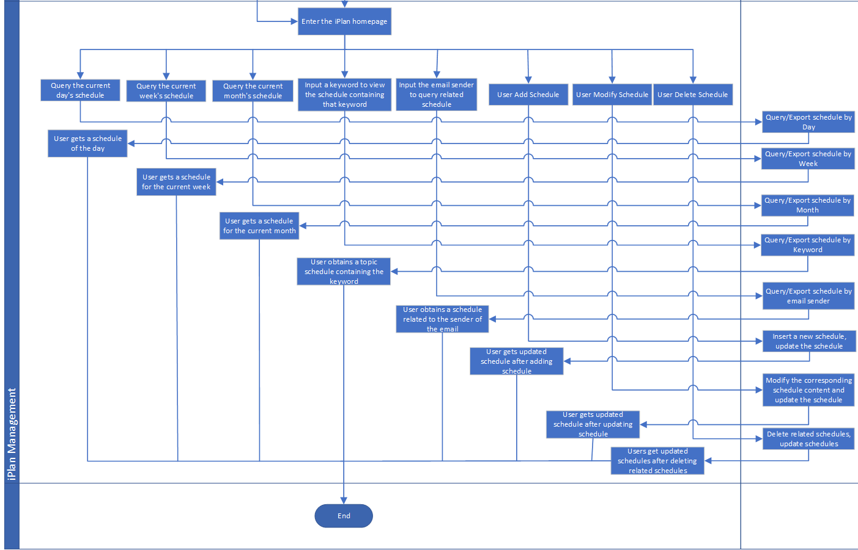
iPlan
Function Introduction
Technology
Requirement items
Schedule management
Users can also create or modify their own schedules
User can delete schedule operations
User query can be divided into: daily query, weekly query, monthly query, query by subject keyword and query by email sender
1. Query all the schedules of the current user whose start time is the current day, week and month, users can get the schedule of the current day, week and month ;
2.By default, the ten words with the highest frequency of keywords are displayed as hot words, and users can query directly based on hot words or manually input keywords. (Split word algorithm)
3.Users can search by sender email to get the relevant schedule
4. Users can export the results of the query as an excel document

Slide 11
03
Technology

Slide 12
iPlan
Function Introduction
Technology
Requirement items
Technology
Front end ：
vue
Back end ：
springboot+mybatis-plus+mysql
microsoft.exchange.webservices (EWS)
Similarity
Word2vec
HanLP Tokenizer
easyexcel

Slide 13
04
Requirement items

Slide 14
iPlan
Function Introduction
Technology
Requirement items
Requirement items
requirement code | requirement content | developer
FD20231001 | user registration(front-end development) | Huang Deyu
BD20231002 | user registration(back-end development) | Huang Deyu
FD20231003 | user login(front-end development) | Huang Deyu
BD20231004 | user login(back-end development) | Huang Deyu
FD20231005 | configure email information(front-end development) | Huang Deyu
BD20231006 | configure email information(back-end development) | Huang Deyu
FD20231007 | synchronize email data(front-end development) | Liu Zhiqing
BD20231008 | synchronize email data(back-end development) | Xie Guangwei
FD20231009 | synchronize calendar data(front-end development) | Liu Zhiqing
BD20231010 | synchronize calendar data(back-end development) | Xie Guangwei
BD20231011 | divide topics into parts of speech(back-end development) | Xie Guangwei

Slide 15
iPlan
Function Introduction
Technology
Requirement items
Requirement items
requirement code | requirement content | developer
BD20231012 | count title words frequency(back-end development) | Xie Guangwei
BD20231013 | analyze title words similarity(back-end development) | Huang Deyu
FD20231014 | add schedule(front-end development) | Liu Zhiqing
BD20231015 | add schedule(back-end development) | Huang Deyu
FD20231016 | update schedule(front-end development) | Liu Zhiqing
BD20231017 | update schedule(back-end development) | Huang Deyu
FD20231018 | delete schedule(front-end development) | Liu Zhiqing
BD20231019 | delete schedule(back-end development) | Huang Deyu
FD20231020 | search the day’s schedule(front-end development) | Liu Zhiqing
BD20231021 | search the day’s schedule(back-end development) | Xie Guangwei
FD20231022 | search the week’s schedule(front-end development) | Liu Zhiqing

Slide 16
iPlan
Function Introduction
Technology
Requirement items
Requirement items
requirement code | requirement content | developer
BD20231023 | search the week’s schedule(back-end development) | Xie Guangwei
FD20231024 | search the month’s schedule(front-end development) | Liu Zhiqing
BD20231025 | search the month’s schedule(back-end development) | Xie Guangwei
FD20231026 | search schedule by keyword(front-end development) | Liu Zhiqing
BD20231027 | search schedule by email(back-end development) | Huang Deyu
FD20231028 | search calendar by email(front-end development) | Liu Zhiqing
BD20231029 | search schedule by email(back-end development) | Huang Deyu
FD20231030 | export schedule Excel(front-end development) | Liu Zhiqing
BD20231031 | export schedule Excel(back-end development) | Xie Guangwei
ID20231032 | interface documentation desgin | Huang Deyu
DB20231033 | database design | group

Slide 17
iPlan
Function Introduction
Technology
Requirement items
Time of completion
finished
ID20231032、DB20231033
4.20
FD20231001、BD20231002、FD20231003、BD20231004、FD20231009、FD20231014
BD20231015、FD20231016、BD20231017、FD20231020、BD20231021
5.4
FD20231005、BD20231006、FD20231018、BD20231019、FD20231022、BD20231023
5.18
FD20231007、BD20231008、BD20231010、BD20231011、BD20231012、BD20231013
FD20231024、BD20231025
5.31
FD20231026、BD20231027、FD20231028、BD20231029、FD20231030、BD20231031

Slide 18
Thanks！

